Slide 1


Mini Project – Proposal Seminar
On
“Smart schedular”
Dept. of CS&E ( DATA SCIENCE)
Adichunchanagiri Institute of Technology
Chikkamagaluru - 577102
Presented By, Under the Guidance
AAFTAB (4AI23CD001) Prof. SHALINI I S
ROHAN H G (4AI23CD042)
SHREYAS M M (4AI23CD051)
TARUN N V (4AI23CD057)
GROUP NUMBER:10

Slide 2
AGENDA
About the project
Motivation
Existing System
Proposed System
Problem Statement
Tools and Technology
Expected Outcomes

Slide 3
ABOUT THE PROJECT
The project aims to automate and optimize academic timetables and seating arrangements using Artificial Intelligence.
It replaces manual scheduling with an intelligent system that saves time and reduces human error.
The system uses Genetic Algorithm and Google OR-Tools for smart scheduling and resource allocation.
teachers can input subjects, hours, and class details, and the system generates optimized timetables.
Seating arrangements are randomly generated, ensuring fairness and no repetition.

Slide 4
MOTIVATION
Manual timetable creation is time-consuming and often clashes.
Teachers face clashes and workload imbalance when handling multiple classes.
Seating arrangements during exams are difficult to manage manually.
Motivation came from the need to reduce workload and use AI for smarter academic planning.

Slide 5

EXISTING SYSTEM
.
In most colleges, timetables and seating arrangements are created manually.
No automation or optimization is used in current methods.
Updating or changing schedules is time-consuming.
Exam seating and attendance are maintained using spreadsheets or paper records
Existing tools (like Excel or basic web apps)

Slide 6
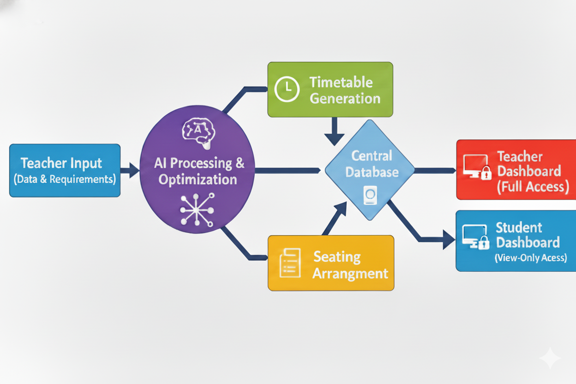
PROPOSED SYSTEM

Slide 7
PROBLEM STATEMENT
The managing academic activities, such as timetable creation, and seating arrangements. These tasks are time-consuming, prone to errors, and lack automation.
This project aims to address the challenges by introduces an AI-powered solution to streamline these processes, enhance accuracy, and reduce the workload for faculty and administrators.

Slide 8
TOOLS AND TECHNOLOGY
Backend: Django (Python)
Frontend: React.js
Database: MySQL
AI Techniques: Genetic Algorithm and OR-Tools
Data visualization : Matplotlib
PDF Generation: ReportLab

Slide 9
EXPECTED OUTCOMES
The system will generate clash-free timetables automatically for each class.
It will create optimized seating arrangements that avoid repetition and crowding.
Teachers can download timetables and seating plans in PDF format.
Students can view their class timetable and seating arrangement through their dashboard.
Overall, the system will ensure time efficiency, and reduced manual effort.

Slide 10
Thank You!
Any Questions?

